Slide 1

PROJECT REPORT
2022AIM1007

Slide 2


2
OVERVIEW
Problem
Implementation
Theoretical
Conclusion
Results
Methodology

Slide 3

PROBLEM
3
First Problem
Implementation of Baseline Methodology correctly
Generation of sets of powered nodes from directional dataset
Second Problem
Correct implementation and future algorithm to reduce execution time and no. of transmitters.

Slide 4
FORMULATION
4
Consider a wireless sensor network consisting of N nodes, each characterized by its location in a 2D space (x,y) and a communication radius R. The goal is to determine the optimal placement of transmitters with directional antennas to cover as many nodes as possible while minimizing the number of transmitters needed.

Slide 5

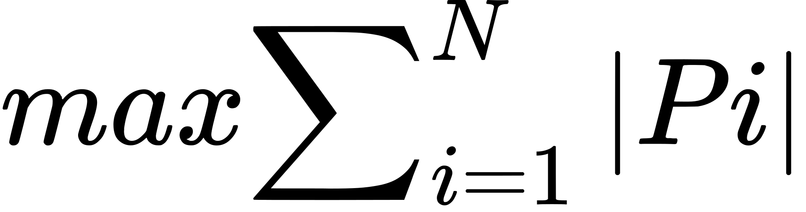
FORMULATION
5
Let:
N be the total number of nodes in the network.
i be the index representing a specific node.
Pi​ be the set of powered nodes when considering the transmitter at node i.
be the beam angle of the directional transmitter.
dij​ be the Euclidean distance between nodes i and j.
α be the angle between the line connecting nodes i and j and the x-axis.
The objective is to find the placement of transmitters, T, such that the union of powered nodes across all transmitters is maximized

Slide 6
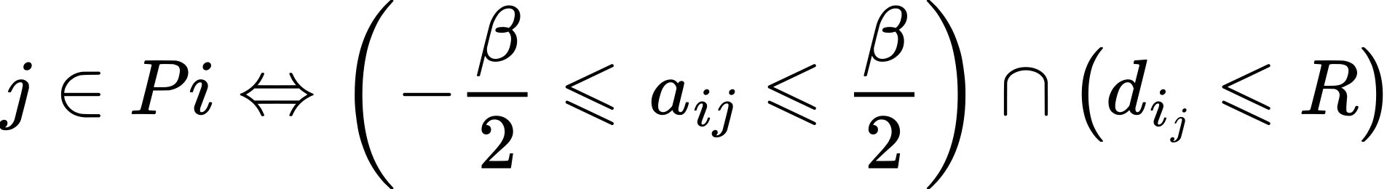
FORMULATION
6
Subject to the constraint that a node j is powered by transmitter i if it lies within the beam angle and communication radius:
Here, αij​ is the angle between the line connecting nodes i and j and the x-axis, and ∣Pi​∣ is the cardinality of the set Pi​.

Slide 7

7
Overview :
The goal is to strategically place transmitters with directional antennas to cover a set of nodes in a 2D space. The problem involves finding the optimal placement of transmitters to maximize the coverage of powered nodes while minimizing the number of transmitters needed.
Assumptions :
No of nodes , grid size are fixed in dataset. beam angle to be constant .
Transmitter antenna is directional, Node antenna is omnidirectional.

Slide 8


EVALUATION PARAMETERS
8
EXECUTION TIME
Execution time for finding sets for complete dataset.
NO. OF TRANSMITTERS
Minimum no of transmitters required for covering whole network.

Slide 9

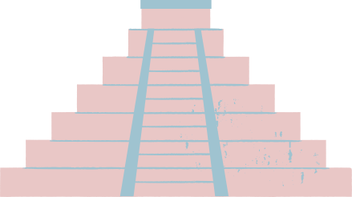
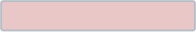
9
METHODOLOGY
Further Research
Optimization
Validation
Visualization
Implementation
Results Analysis
Algorithm Design
Data Preprocessing
Problem definition
Mathematical Formulation

Slide 10


IMPLEMENTATION
10
Reading Dataset
Validation
Reading csv file data for node location and radii
Verifying results with network of nodes
and checking consistency.
Powered Sets Generation
Visualization
If node falls within beam angle and radii of nodes capture transmitter, nodes are powered. Rotating transmitter with fixed beam from 0-360.
Various plots of node coverage, no of transmitters vs Nodes etc.

Slide 11



﻿RESULTS
11
For 50x10x1.csv
Nodes - 10
Grid Size - 50x50
Uniqueness - 1

Slide 12
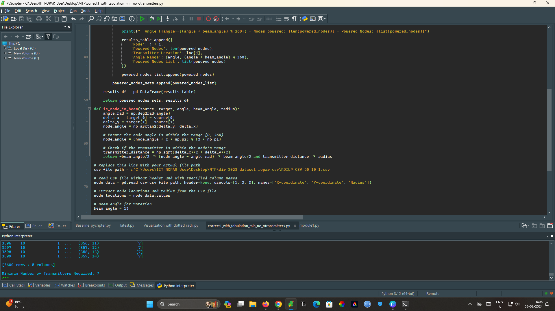

Slide 13
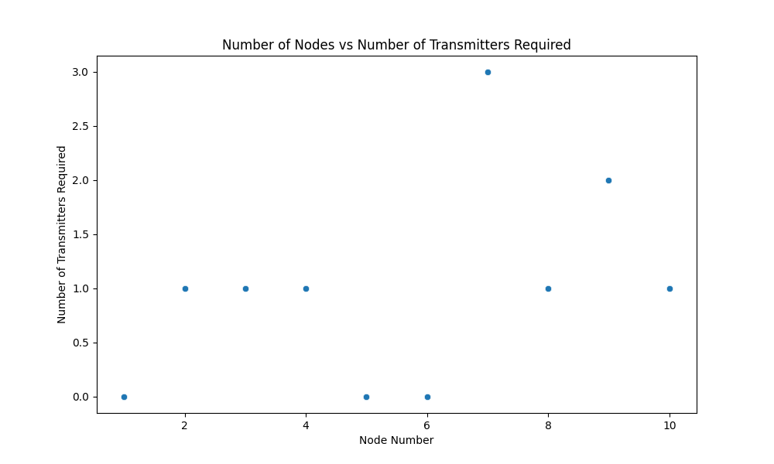
﻿RESULTS
13

Slide 14
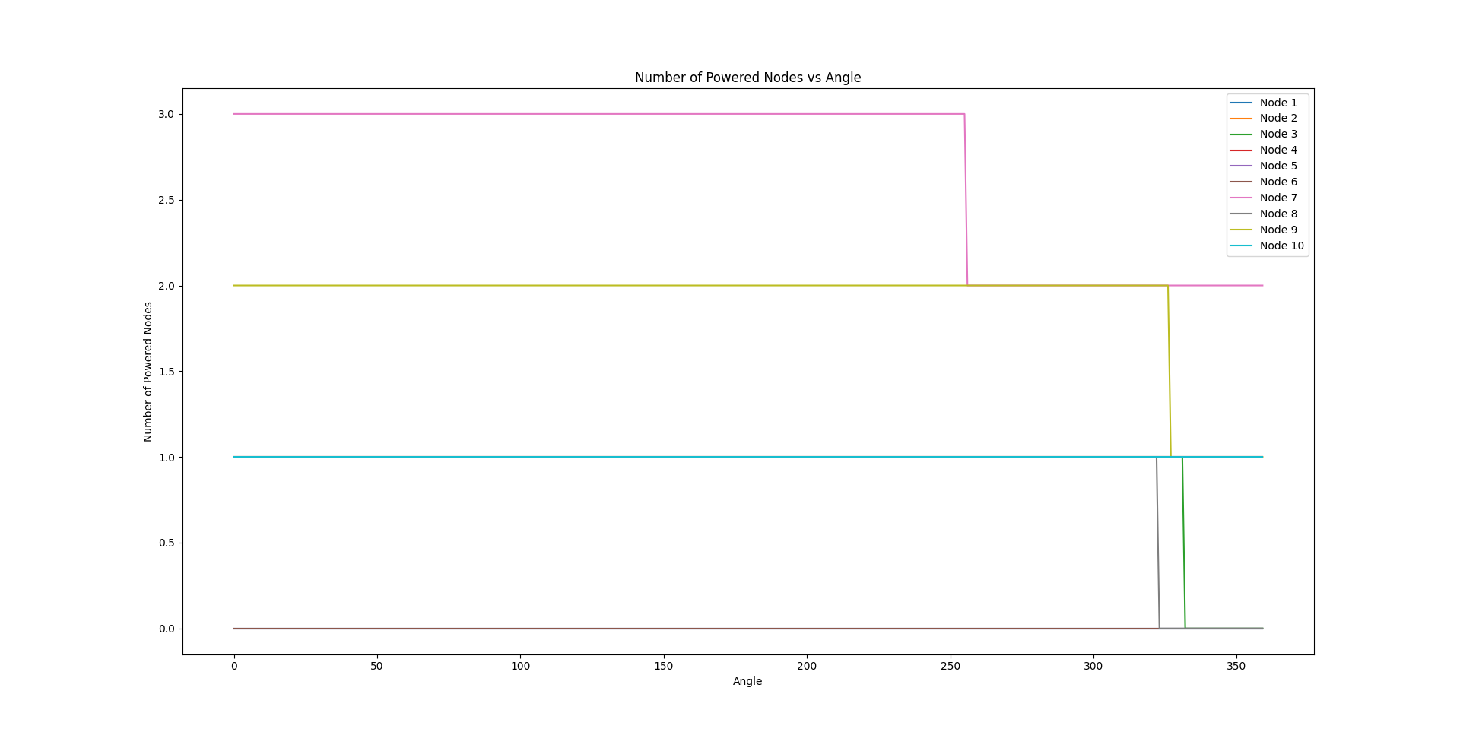
﻿RESULTS
14

Slide 15
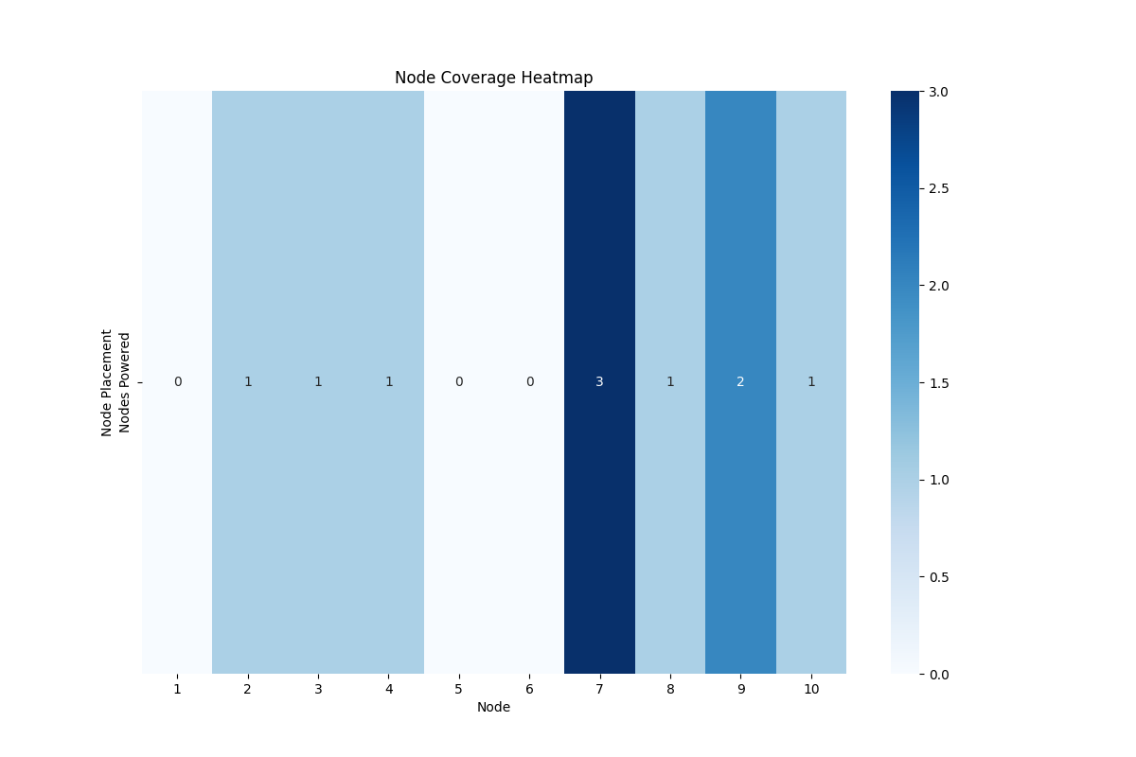
﻿RESULTS
15

Slide 16
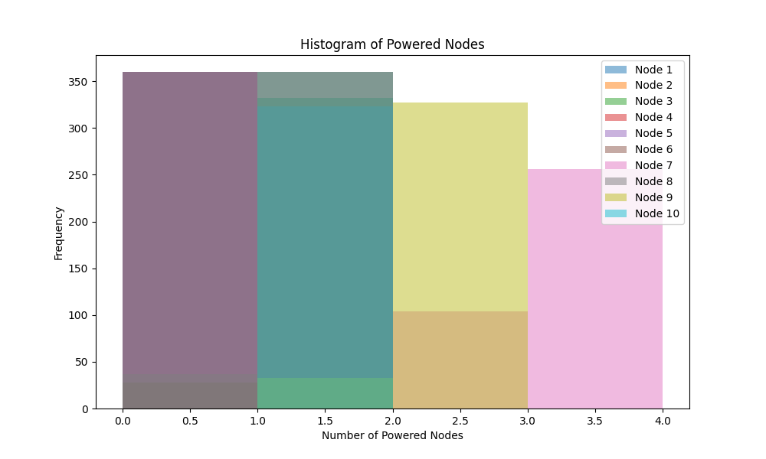
﻿RESULTS
16

Slide 17
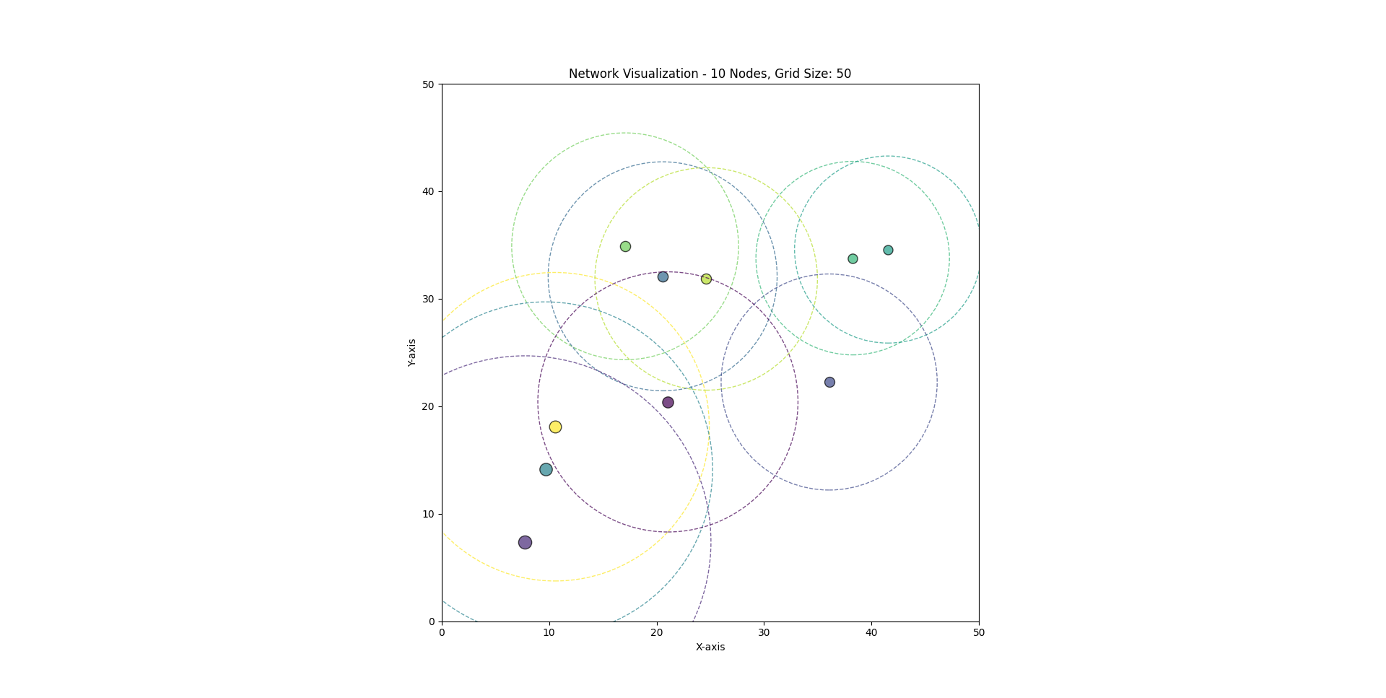
NETWORK VISUALIZATION
17

Slide 18
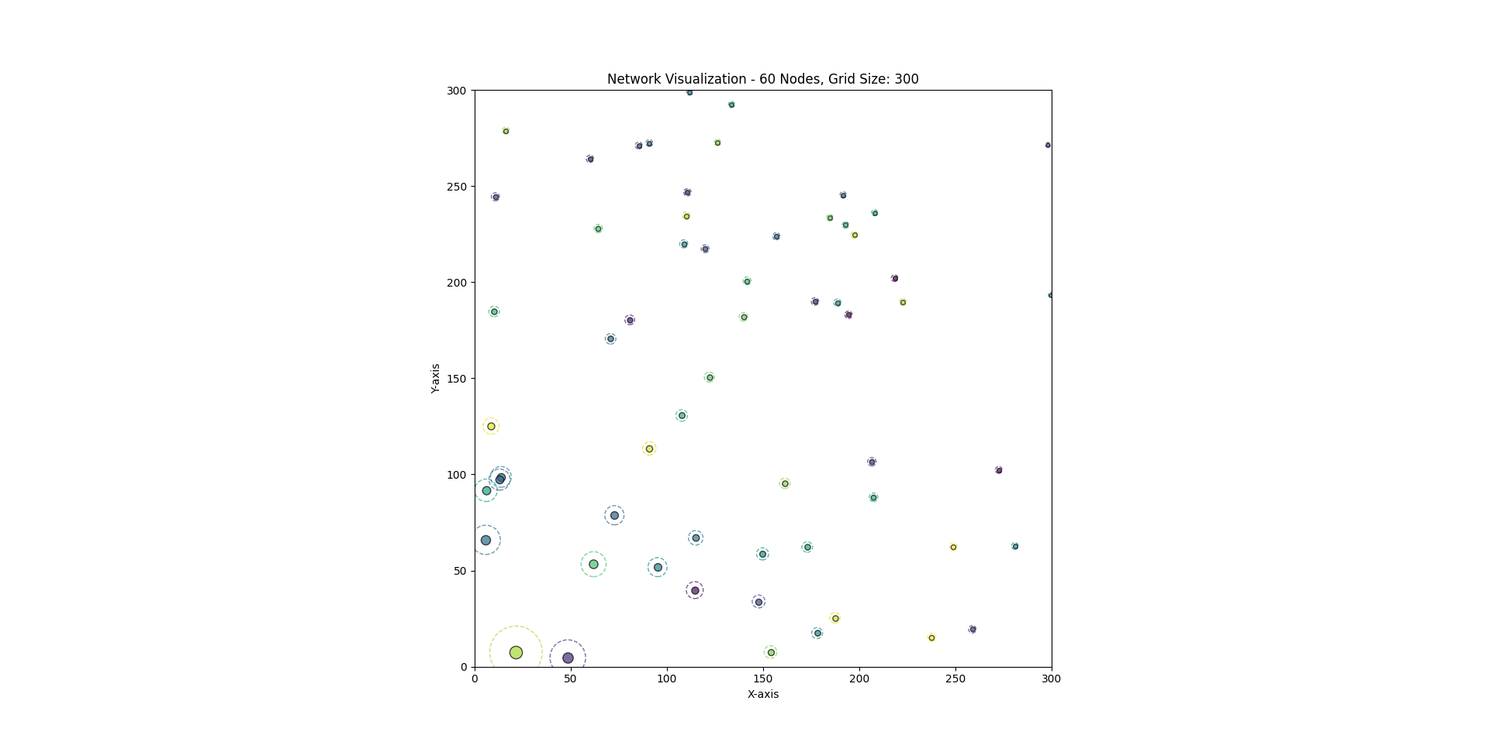
NETWORK VISUALIZATION
18

Slide 19
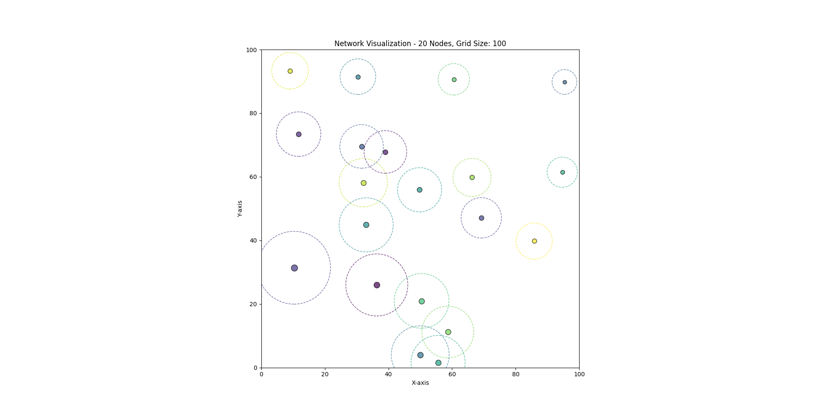
NETWORK VISUALIZATION
19

Slide 20


20
FUTURE WORKS
Create more efficient ways to output results. e.g tabular, output to file.
Work on Methodology 2 , currently testing density based placement of transmitter.
Run complete dataset together for evaluation and compare results.

Slide 21

ISSUES FACED
21
Validation
Real time validation of results, and visualization.
Evaluation
Time and No. of Transmitters evaluation.

Slide 22
THANK YOU

